Slide 1

Player management system 15CSE333 – Advanced DBMS Amrita school of engineering Bengaluru

Slide 2
Team details
Project Title: Distributed Player Management System
Team Members :
BL.EN.U4CSE18073 – Kaazima Ifrah
BL.EN.U4CSE18083 – Nuthi Sriram
BL.EN.U4CSE18091 – Potti Priya

Slide 3
overview
Problem Statement
Motivation
Technology Stack
System Features
Live Demo
References

Slide 4
Problem statement
Problem:
The problem of planning, organization, time management, on proper user of resources (cricket players), budget, allocation of matches.
Effect:
The impact of these problems is not proper completion of cricket matches at its specific time.
Objective & Scope:
To find out the application of sports management system
To provide information and manage the system regarding cricket sports events

Slide 5

Motivation
To digitize and simplify the ways in which cricket players’ statistics are analyzed and maintained
To minimize the cumbersome process that usually takes place while analyzing and maintaining the statistics
To reduce the hard manual paperwork and make the entire process trouble-free

Slide 6

Technology stack
Frontend: HTML, CSS, JavaScript, EJS
Middleware: Mongoose
Backend: Node.js
Database: MongoDB

Slide 7
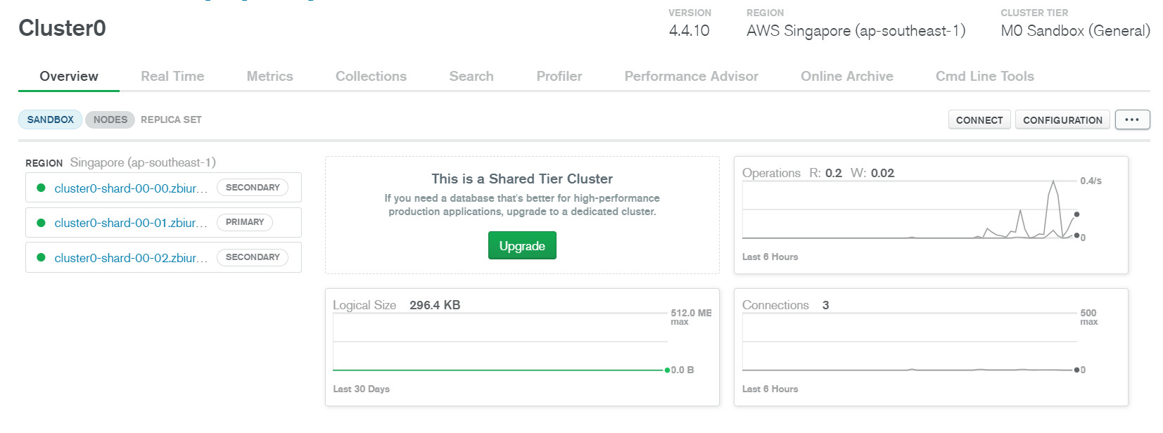

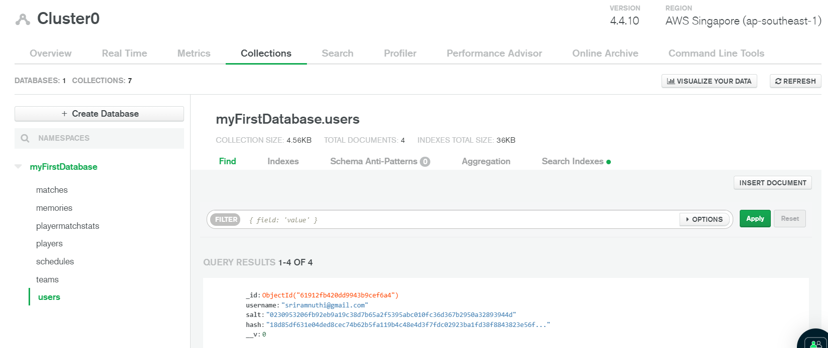
Mongodb
Document-based, NoSQL database
Uses JSON like documents to store data
MongoDB environment provides a server
Server converts JSON to BSON
Fast and efficient

Slide 8

SYSTEM FEATURES
Stats man dashboard:
Take notes in the app in form of mini microblogging
Continuously keep track of the cricket player & match statistics
Make schedule of the matches
Selection Committe dashboard:
Access to players personal information (mobile number, email, etc.)
View access to cricket player & match stats
View access of the cricket schedule
Enthusiast dashboard:
View access to cricket player & match stats
View access of the cricket schedule

Slide 9


Slide 10
References
https://en.wikipedia.org/wiki/Cricket_statistics
https://docs.mongodb.com/manual/crud/
https://www.mongodb.com/atlas/database

Slide 11
Thank you

